Slide 1
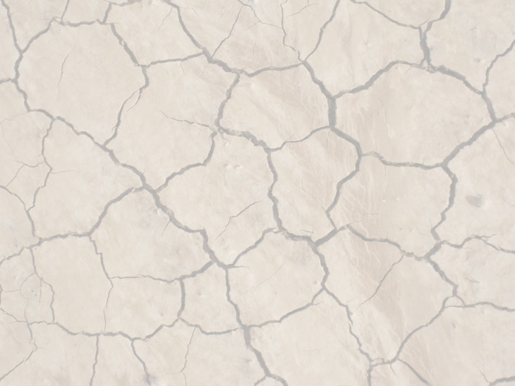





Bridging the Gap Between Local and Scientific Knowledge to Improve the Effectiveness of Evaluation of Desertification Mitigation and Restoration Actions
Trevor Jones
UA Space Grant Symposium
April 21, 2012
Space Grant Mentor: Dr. Barron Orr

Slide 2
Problem Statement
Desertification and Land Degradation
  Drylands make up 41% of the world’s land area; 70% are under threat of severe land degradation known as desertification.
  Affects 1.5 billion people, many of whom are vulnerable
  Costs the U.S. over $42 billion annually.
Current approaches to evaluation are ineffective.
  Desertification is a global problem with local solutions.
  Current evaluation approaches are top-down in nature.
  Evaluations lack local perspectives and knowledge.
  Local people are rarely involved.
Notes:
High resolution = 2m OrbView
“Coarser” resolution = 30m Landsat

Slide 3
Objectives
Can engaging stakeholders be a solution?
  Embracing a participatory approach to the evaluation of past desertification mitigation and restoration actions.
  Making stakeholders producers rather than recipients of evaluation.
  Provide a means for stakeholders to describe their knowledge. Ask rather than tell. What are the impacts of these past actions to address land degradation?
  Develop a method to elicit and rank the criteria stakeholders use to determine if actions work.

Slide 4
Approach
Develop a protocol that engages local stakeholders to not only share their knowledge, but set the criteria for evaluation.
Select a site with
  past mitigation or restoration actions,
  stakeholders interested and willing to participate.
Test the protocol.
Conduct the evaluation.

Slide 5
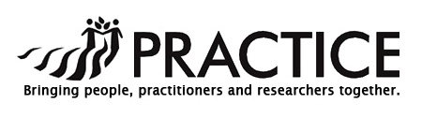
Goals
To link expert scientific advances and traditional knowledge of prevention and restoration practices to improve evaluation and management actions to combat desertification.
Develop collaborative natural resource management platform and translational science strategies that incorporate the inputs of stakeholders at all levels
“Create an international platform of long-term monitoring sites aimed at supporting future synthetic analysis, improving accessibility and use of long long‐term data, and disseminating knowledge of best practices worldwide.”
Being tested as a evaluation protocol in 12 countries. One of them here, in the San Simon Watershed.

Slide 6
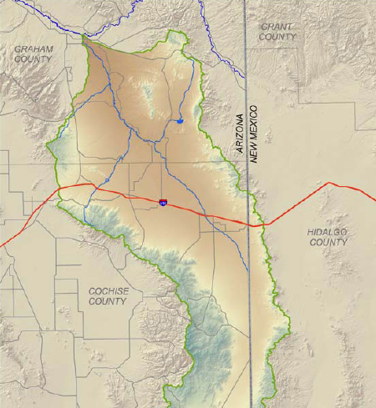
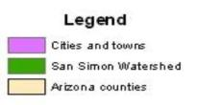
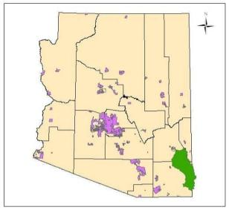
Study Area: San Simon Watershed
Watershed area: about 5,828 km2 (2,250 mi2)

Slide 7
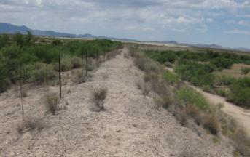
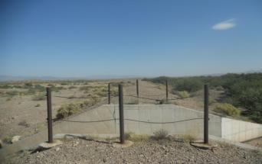
The San Simon Watershed
Identification of actions in place to combat degradation.
  Large Structures (Dams, Dykes)
  Grazing Management (Rotational grazing, long term resting)
  Vegetation conversion of shrub to grass
Development of Indicators to measure the impact of these actions.
  Productivity, plant cover, soil surface condition, above-ground biomass, plant diversity, etc.
Ryan Dyke along main channel of San Simon
“Halfway” detention dam

Slide 8
The next step: moving from listening, to doing.
Who? Students in the Master Watershed Stewards course.
  Local people learning about their watershed.
Developing the protocol
  Factsheet
  Semi-structured interviews
  Evaluation criteria elicitation and ranking
  Stakeholder-driven data collection
Test the protocol
  Group test
  Site visit (field trip)

Slide 9
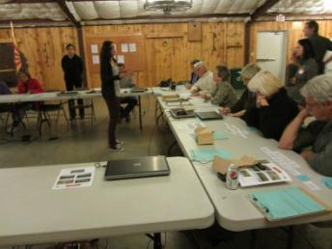
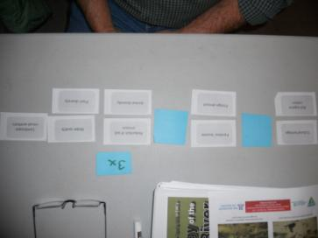
Baseline Assessment & Selection of Evaluation Criteria
Group interviews
  Discussion of actions and potential indicators, recommendation of indicators.
  Baseline assessment of the actions
“Pack of Cards”
  Method to empower stakeholders to be evaluators
  Stakeholders identify the criteria (indicators) they would use to assess impact.
  Then rank the indicators that they developed.
  The math behind this gives the indicators weights of importance
  To be in a later step where the weights and data for each indicator are combined.

Slide 10
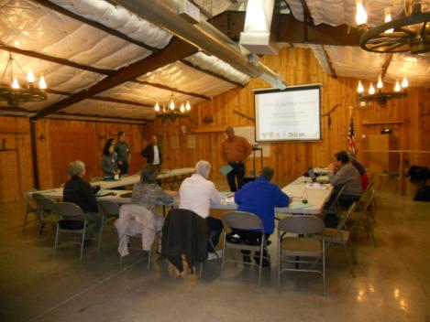
PhotoVoice
Participants are asked to represent their community or point of view by taking photographs, discussing them together and developing narratives to go with their photos.

Slide 11
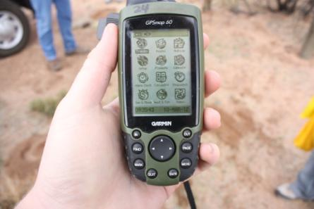
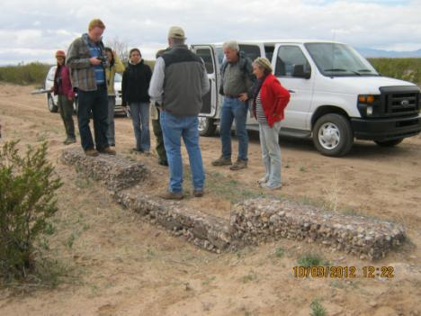
We have included a geospatial element using GPS, GoogleMaps, and geotagging.
Stakeholders learning from each other

Slide 12
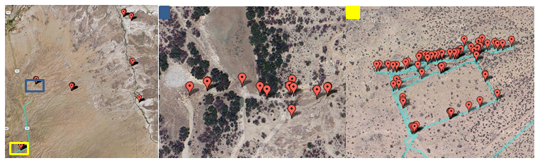
Results
Are they engaged? Are they changing from passive recipients of evaluation information into active developers of evaluation information?
Notes:
Yes – They are getting much more involved! They pay attention! They have said themselves that they are more knowledgeable and understanding of a topic they previously didn’t even know existed! They have ideas and contribute to changes in the way the weigh our indicators.

Slide 13
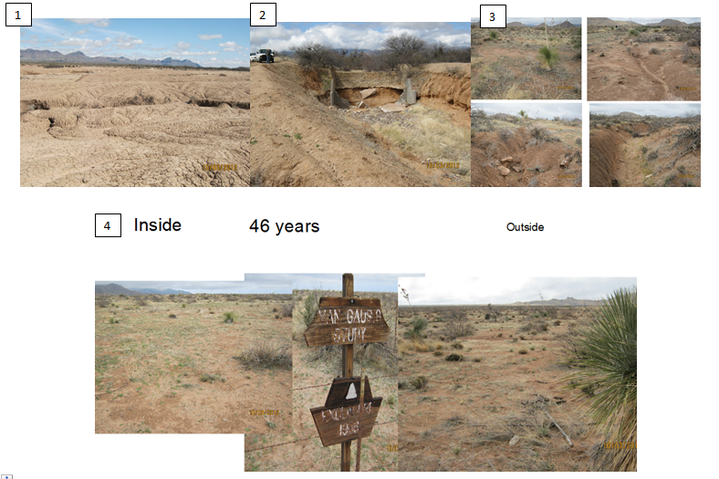
FROM March 15 Discussion: This photo (4) demonstrates over the course of 46 years the difference between the inside and outside of a grazing enclosure. I find it to be an interesting comparison, asking if there is a noticeable difference between how much vegetation is inside, and out.
Moving onto another slide (3) that shows the north side of the grazing enclosure. I walked the length of that side taking pictures. It went from 0 erosion to almost 5 feet in 200 yards. This is a result of slope and soil texture.
The final picture (2) is of a washed out dam. It really “pisses me off”.
Notes:
Reformat this… maybe use someone else as an example.

Slide 14
Conclusions
They are engaged
  Social learning, they are learning from each other through doing.
Bridging the gap between geospatial data and real people
  Can we take what we learn from earth science and improve it by adding local knowledge and increasing local understanding?
Refined protocol, indicators and interview methods
  Huge stakeholder emphasis on cultural and aesthetic value.
  These are ecosystem services often underrepresented in expert evaluation.
  70 percent of photos and comments were cultural.

Slide 15


Acknowledgements
University of Arizona Space Grant Consortium
Arizona Remote Sensing Center
Office of Arid Land Studies
United States Bureau of Land Management(BLM)
Gila Watershed Partnership
PRACTICE
Barron Orr, Ph.D.
Bill Brandau, Director, Graham County Cooperative Extension
Taryn Kong
Anahi Ocampo
Denise Garcia
Master Watershed Stewards Students

Slide 16
Thank You!

